Slide 1
Project 2/December Midterm DMII
By: Ruhani Jindal

Slide 2
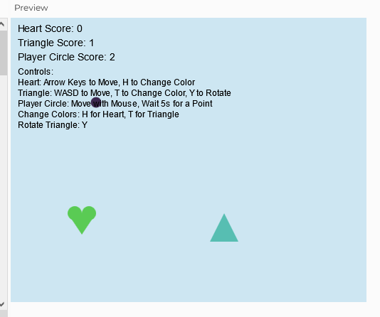
Project Title
The Shape Race

Slide 3
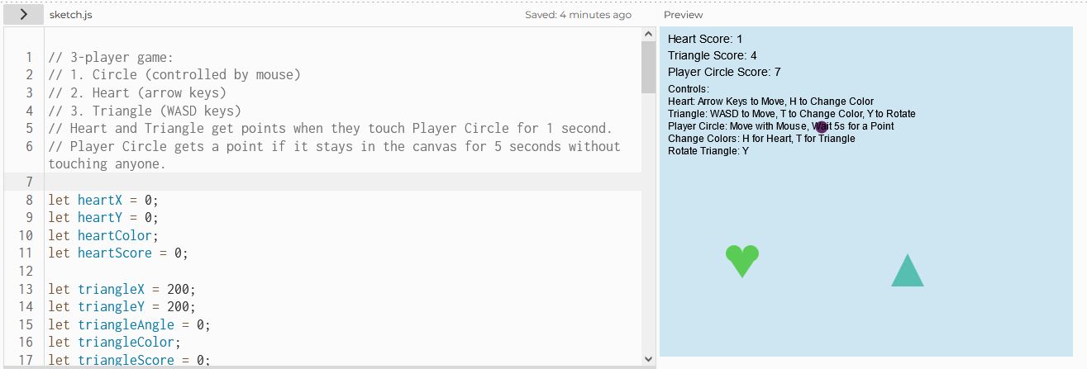
Project Description

Slide 4
Types of Interaction
Keyboard
Control player triangle and heart
Rotate players
Change colours of players
Mouse
Control circle player
Change colours of player based on mouse position

Slide 5
Rough sketch

Slide 6
Colour Palette
Circle: fill(mouseX / 2, mouseY / 3, (mouseX + mouseY) / 3);
Heart: heartColor = color(random(255), random(255), random(255));
Triangle: triangleColor = color(random(255), random(255), random(255));
Text: fill(0); or black
Background: background(205, 230, 242); or soft light blue

Slide 7
PART TWO: Wall Drawing

Slide 8
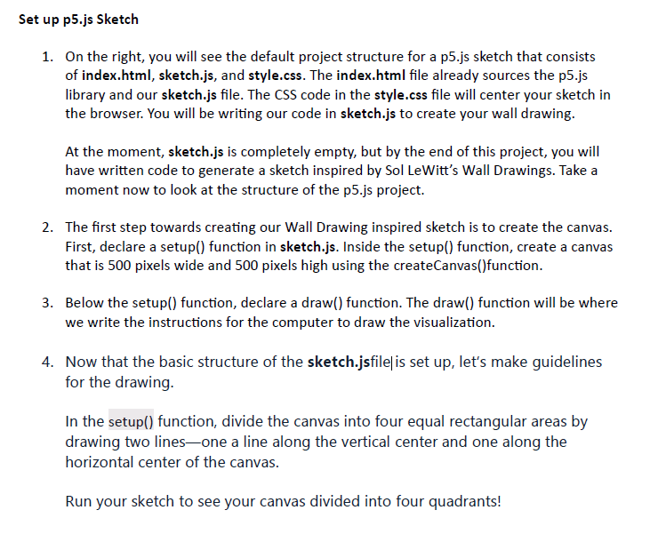
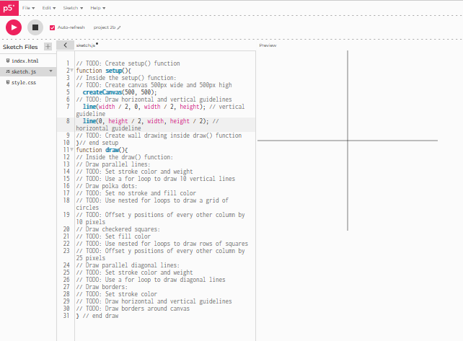
Set up p5.js sketch

Slide 9
Set up p5.js sketch

Slide 10
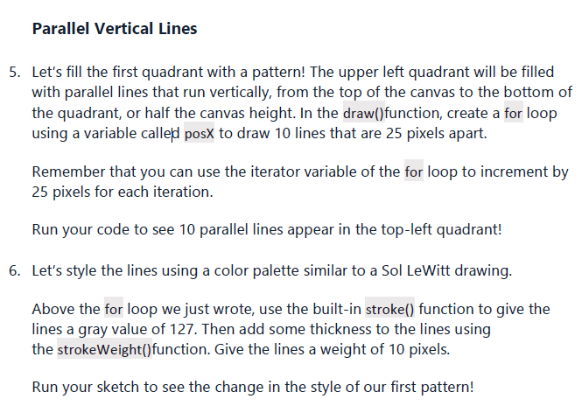
Parallel Vertical Lines

Slide 11
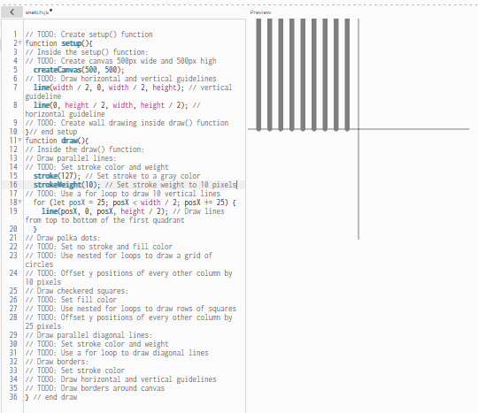
Parallel Vertical Lines

Slide 12
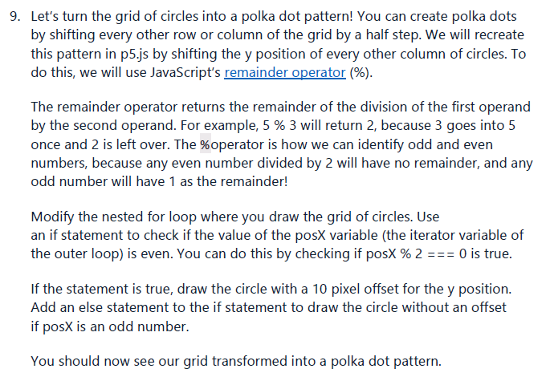
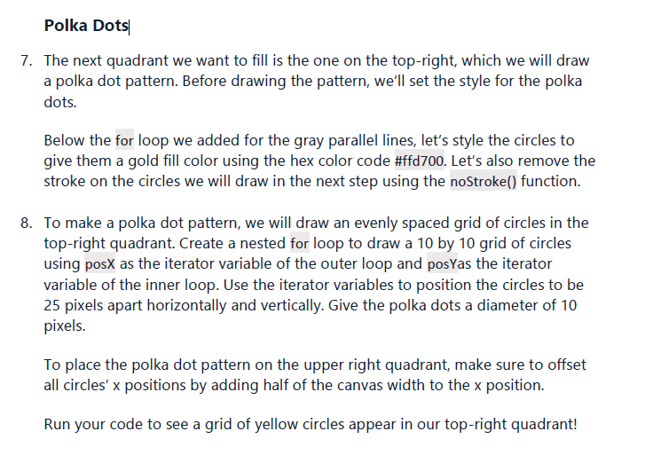
Polka Dots

Slide 13
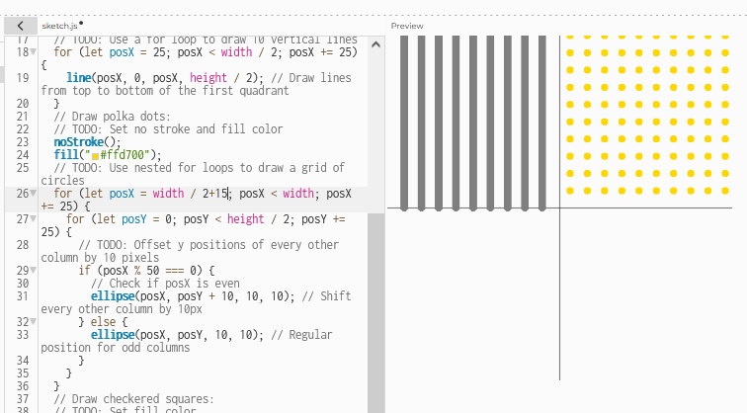
Polka Dots

Slide 14
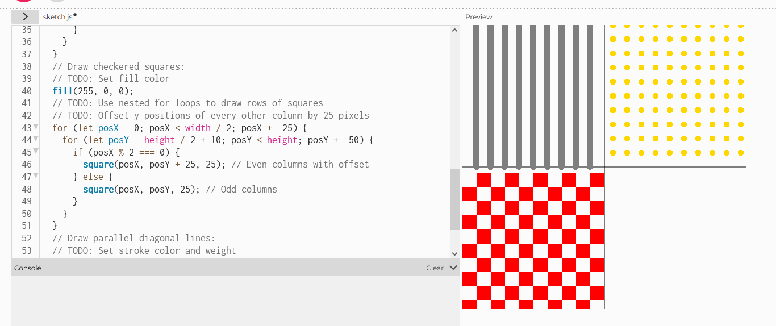
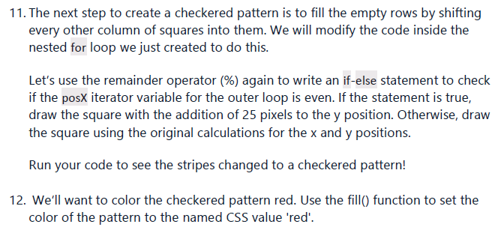
Checkered Squares

Slide 15
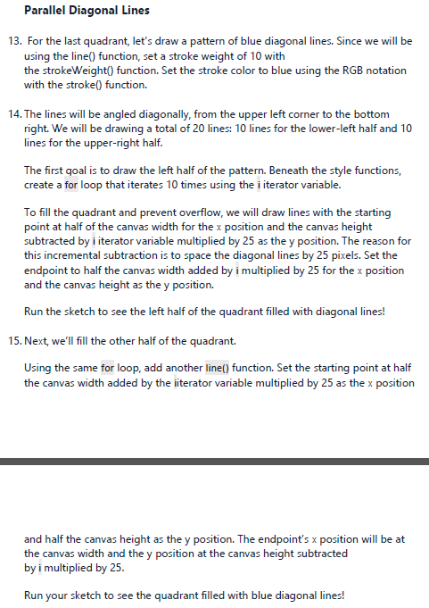
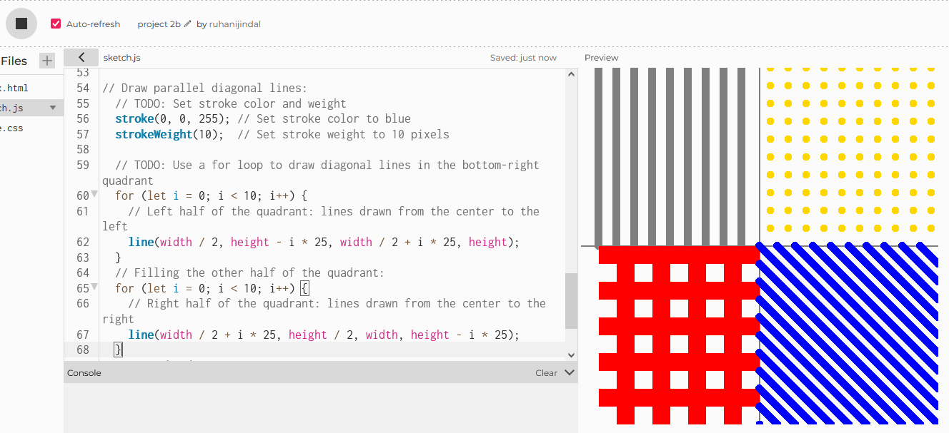
Parallel Diagonal Lines

Slide 16
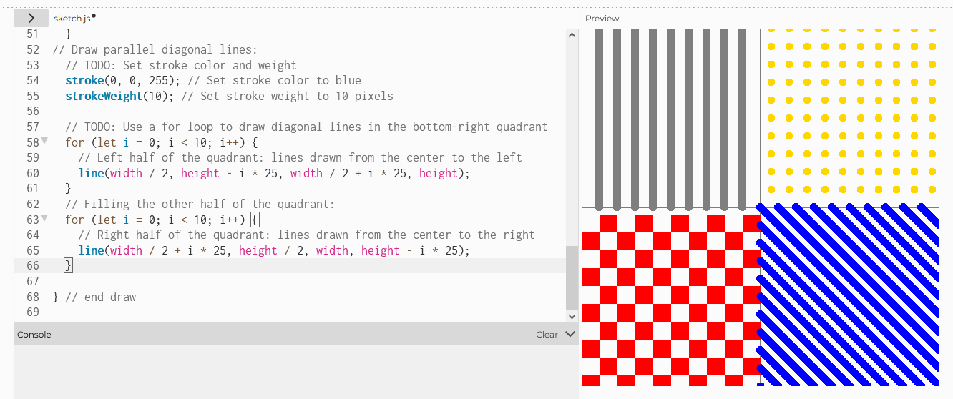
Parallel Diagonal Lines

Slide 17
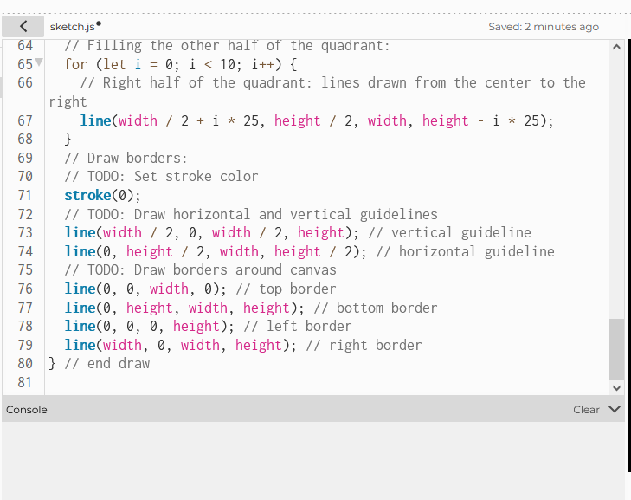
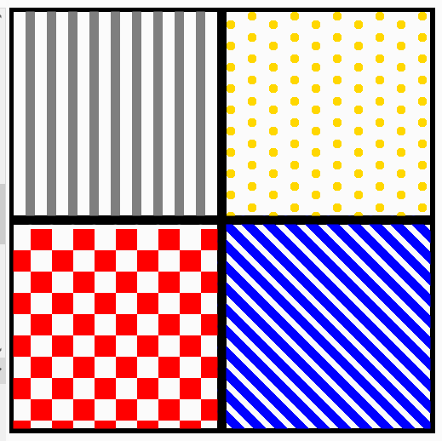
Borders

Slide 18
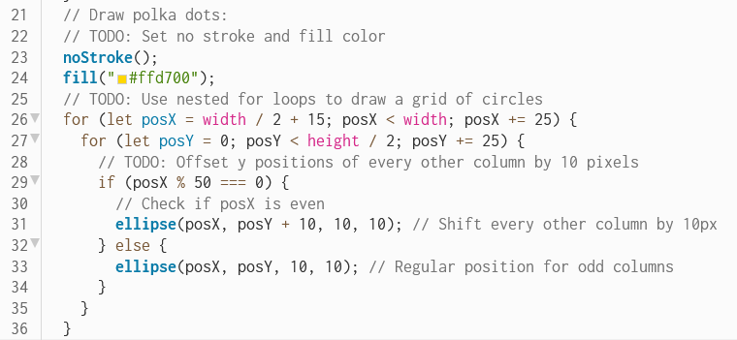
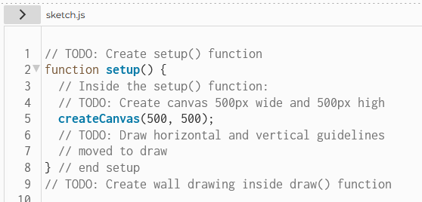
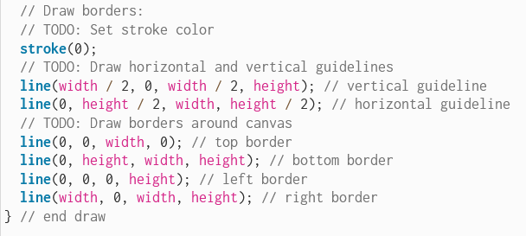
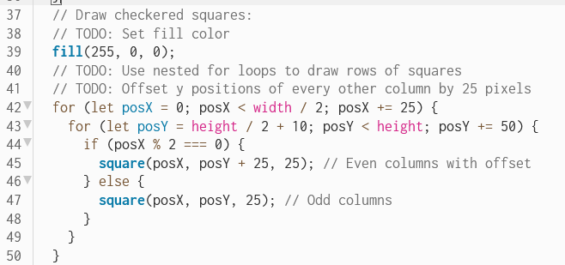
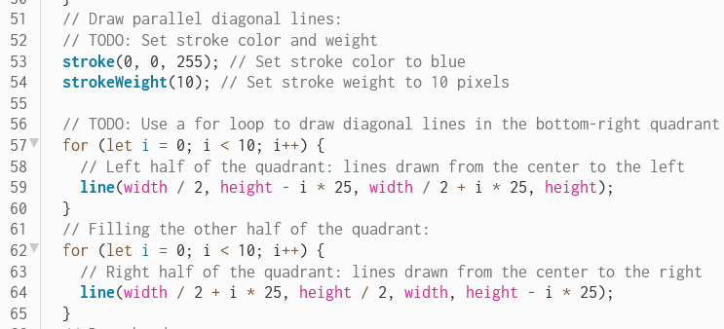
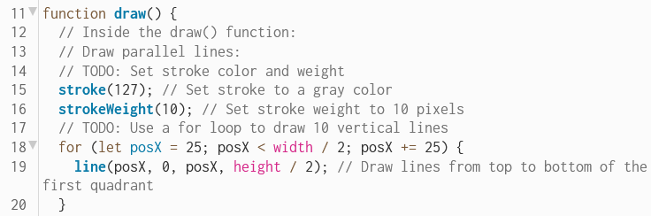
Code

Slide 19
Done!

Slide 20

Thank You For Listening! ☺

